Slide 1

By Bloonagins
Notes:
http://tiny.cc/WW_SA
MARKING KEY: https://webpages.uidaho.edu/drbc/cs383/assignments/04b_PresentationMarkingKey.pdf
Ethan

Slide 2
What’s the goal?
The goal of Wonky Wizards is to progress through and explore the story of Wonk, the old drunken (and infamously unwise) Wizard who runs a shroom-tato farm (potatoes grown out of shrooms).
After a misunderstanding, he finds himself in some trouble: being attacked by waves of goblins and other baddies.
In order to pass each level, you will play as Wonk and attempt to defend the Goal from the incoming enemies!
Notes:
Ethan

Slide 3
Who’s the team?
Ethan Corgatelli, Chandler Calkins,
Gabriel Jones, Zach Heimbigner, Chase Gornick,
David Bush, & Gage Nardi
Notes:
[GROUP]

Slide 4
Storyboard
Notes:
Chandler

Slide 5

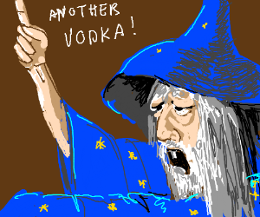
Main Character
You play as Wonk the Wizard: an alcoholic and infamously unwise wizard.
Wonk is an old man with a stupidly entertaining personality who lives as a recluse in a tower in the middle of a forest.
He spends most of his free time study nature, inventing new spells and potions, and getting drunk.
Notes:
Chandler

Slide 6


Storyline
Wonk decides he wants to create a new type of magic vodka out of shroom-tatoes.
He accidentally destroys his shroom-tato farm, and the only other farm is owned by an enchanter named Tim who won’t give him any.
Wonk decides to try to create an invisibility potion to sneak into Tim’s lair and steal some shroom-tatoes.
Notes:
Chandler

Slide 7

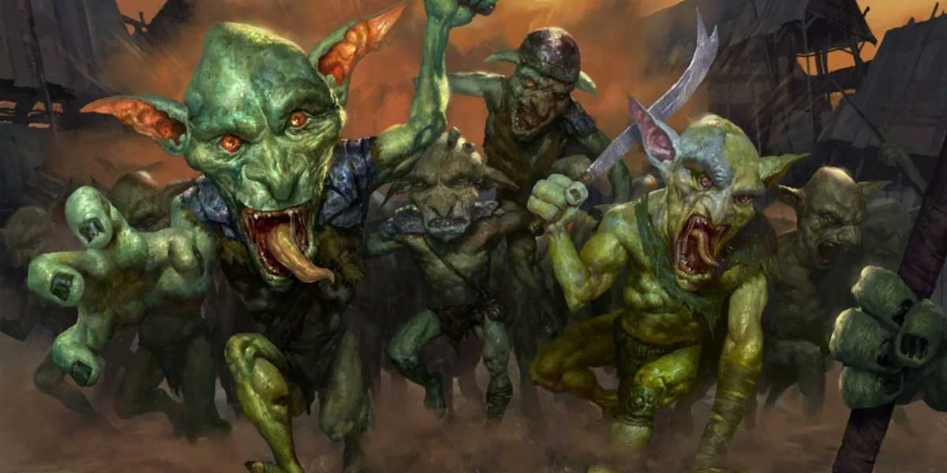
Storyline
Wonk writes a letter to the nearest library asking if they have a recipe for a potion of invisibility, but mispels invisibility as ‘invincibility’.
Wonk sends the letter via pigeon, but some goblin hunters catch the pigeon mid journey.
They read the letter, misinterpret it, and think Wonk is trying to get a potion of invincibility to steal from their leader, “The Great Gob”.
Notes:
Chandler

Slide 8
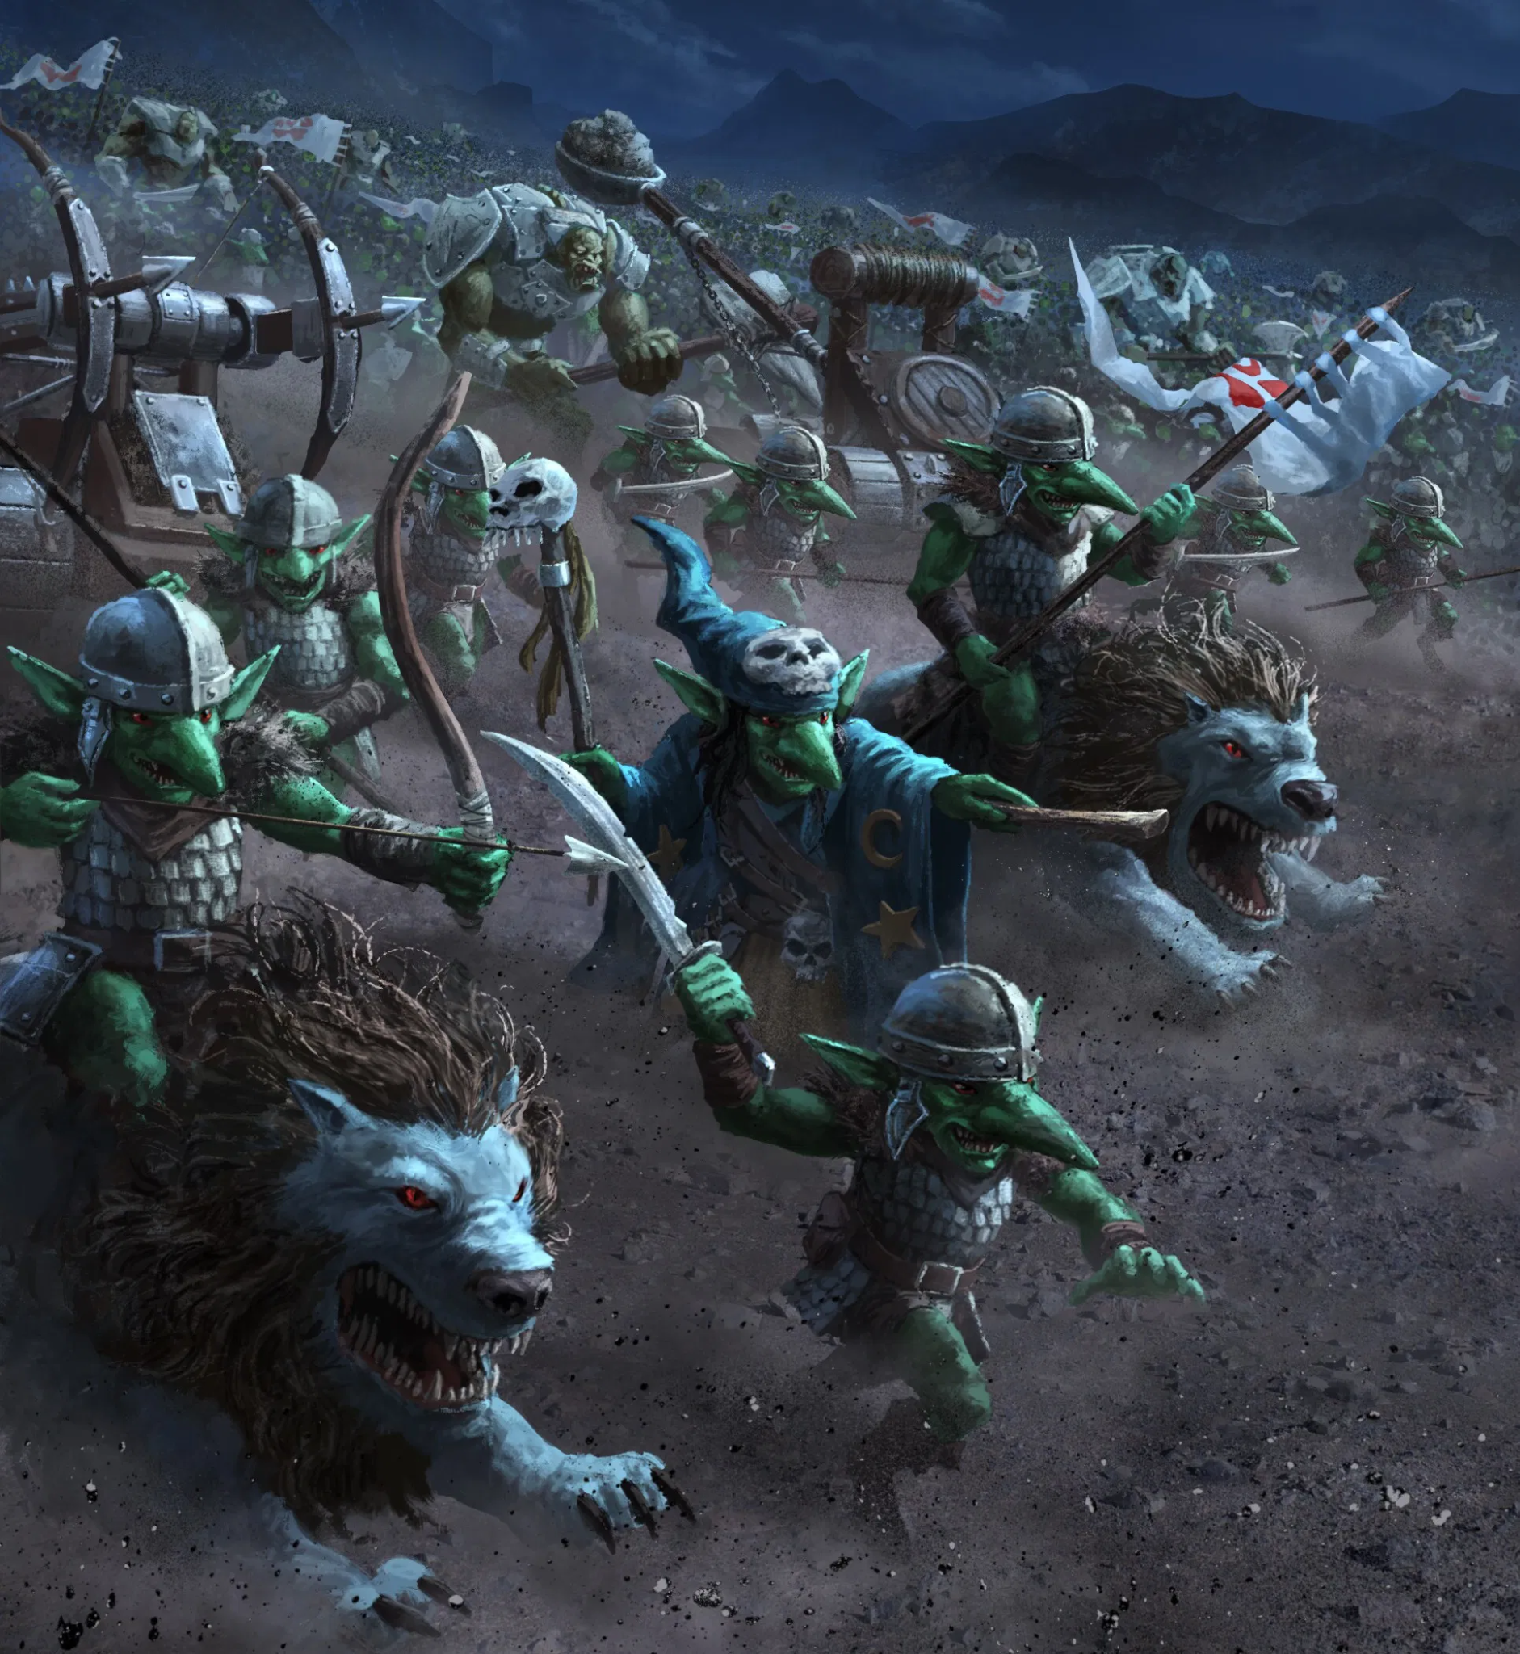
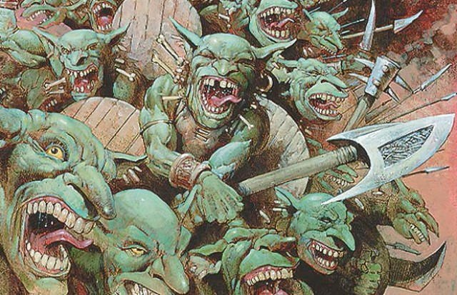
Storyline
The goblins bring the letter to The Great Gob, and he becomes furious at Wonk.
The Great Gob then orders an all out attack on Wonk to prevent him from creating a potion of invincibility.
A goblin army is then sent to attack Wonk’s tower.
Notes:
Chandler

Slide 9
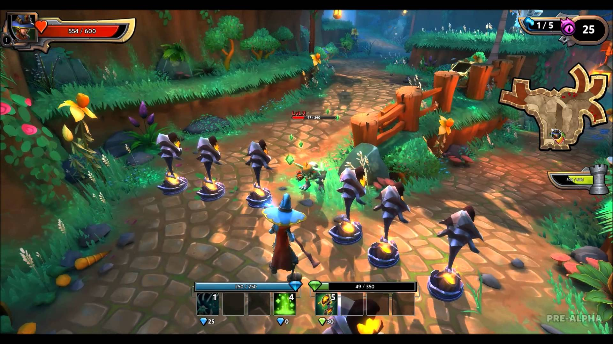
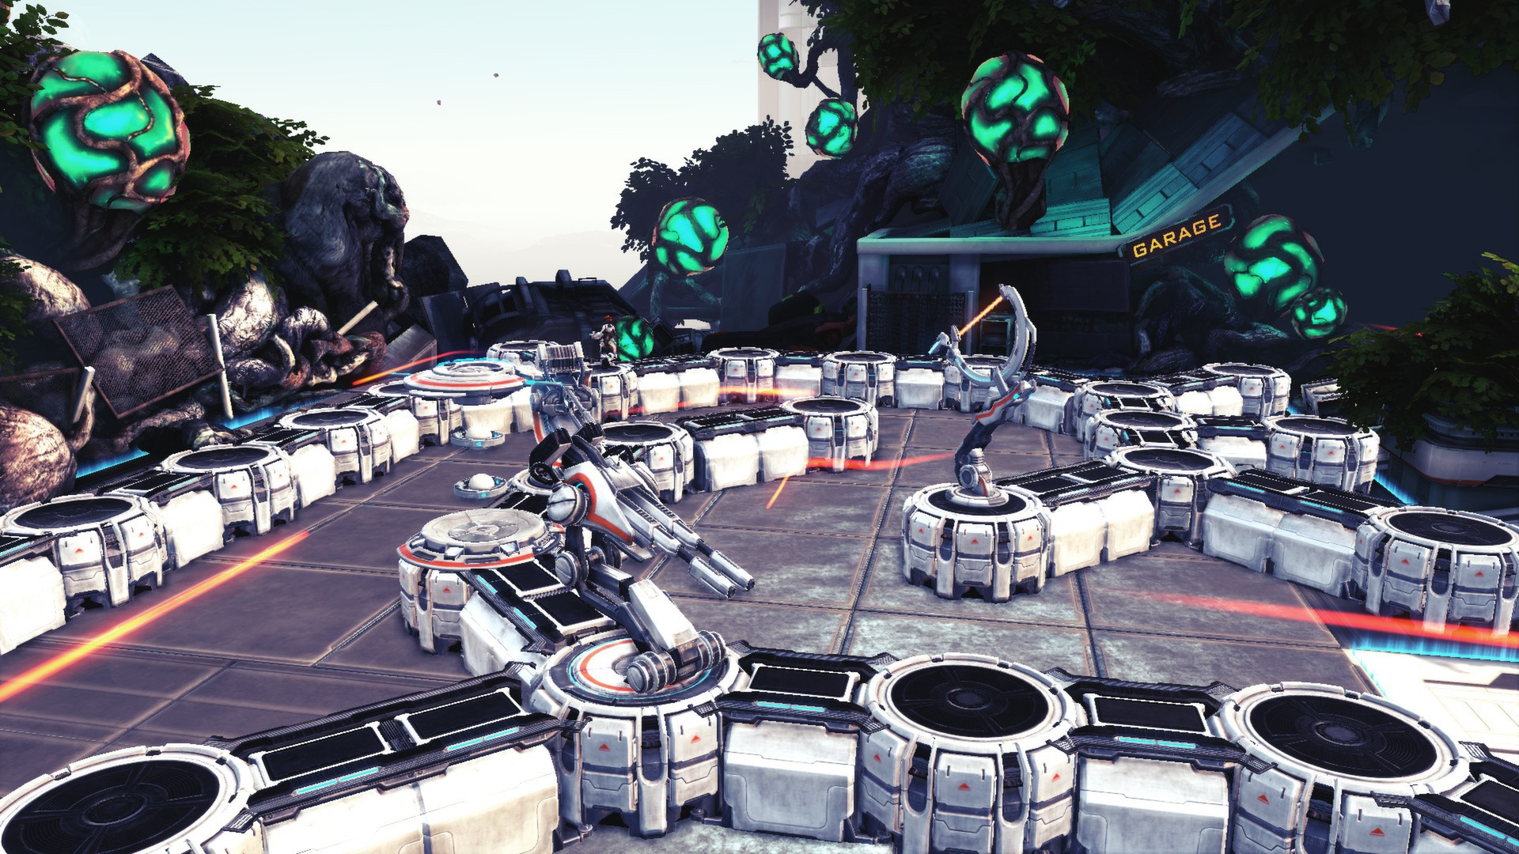
Storyline
Wonk detects the goblins coming early and has time to fortify his tower.
He quickly summons things to help him defend his tower, and between each wave of enemies he heals himself and summons more defenses.
After Wonk defeats the goblin attack, he spends time fortifying his tower and journeys directly to the library to ask them for a invisibility potion recipe.
Notes:
Chandler

Slide 10

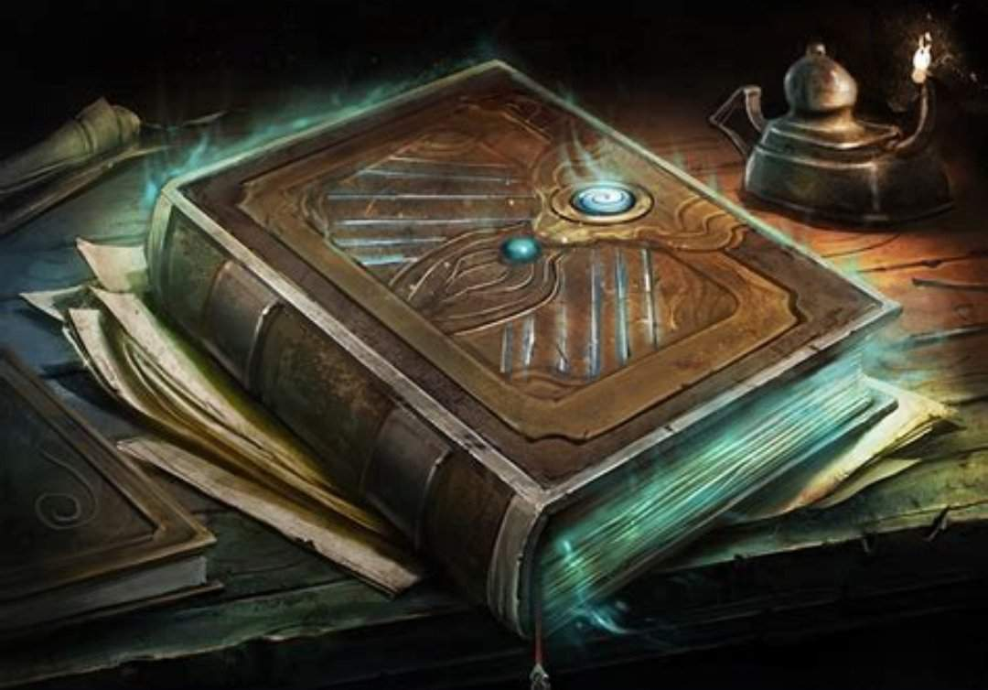
Storyline
Wonk arrives at the library and asks the librarian for a tome that contains a recipe for a potion of invisibility.
The librarian recognizes Wonk from tales he’d heard of his drunkenness and kicks him out of the library.
A goblin army then comes to attack the library, and after Wonk defends it the librarian agrees to help him.
Notes:
Chandler

Slide 11
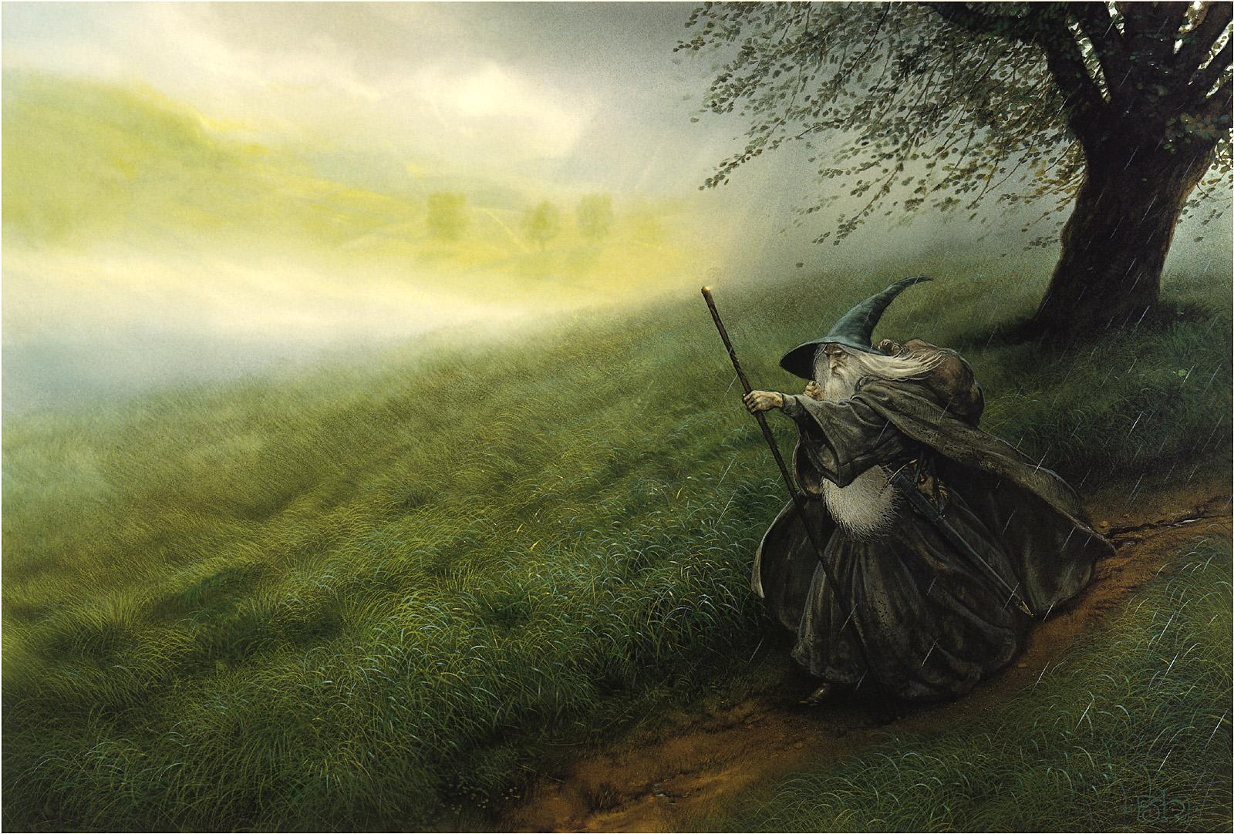
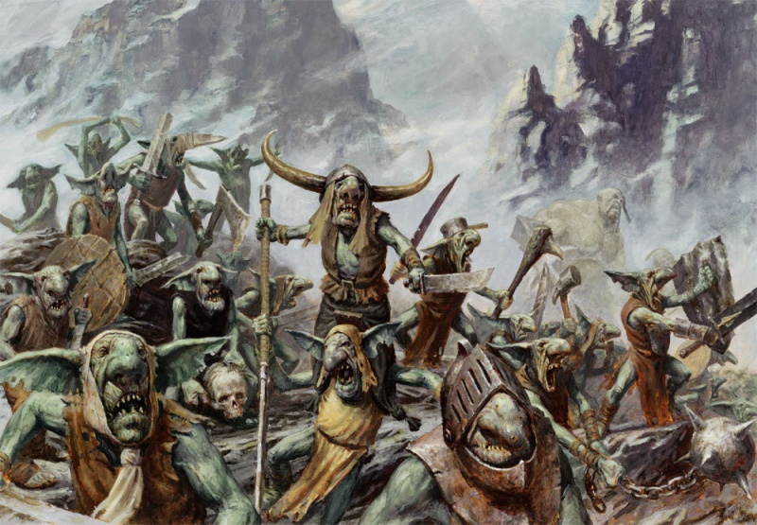
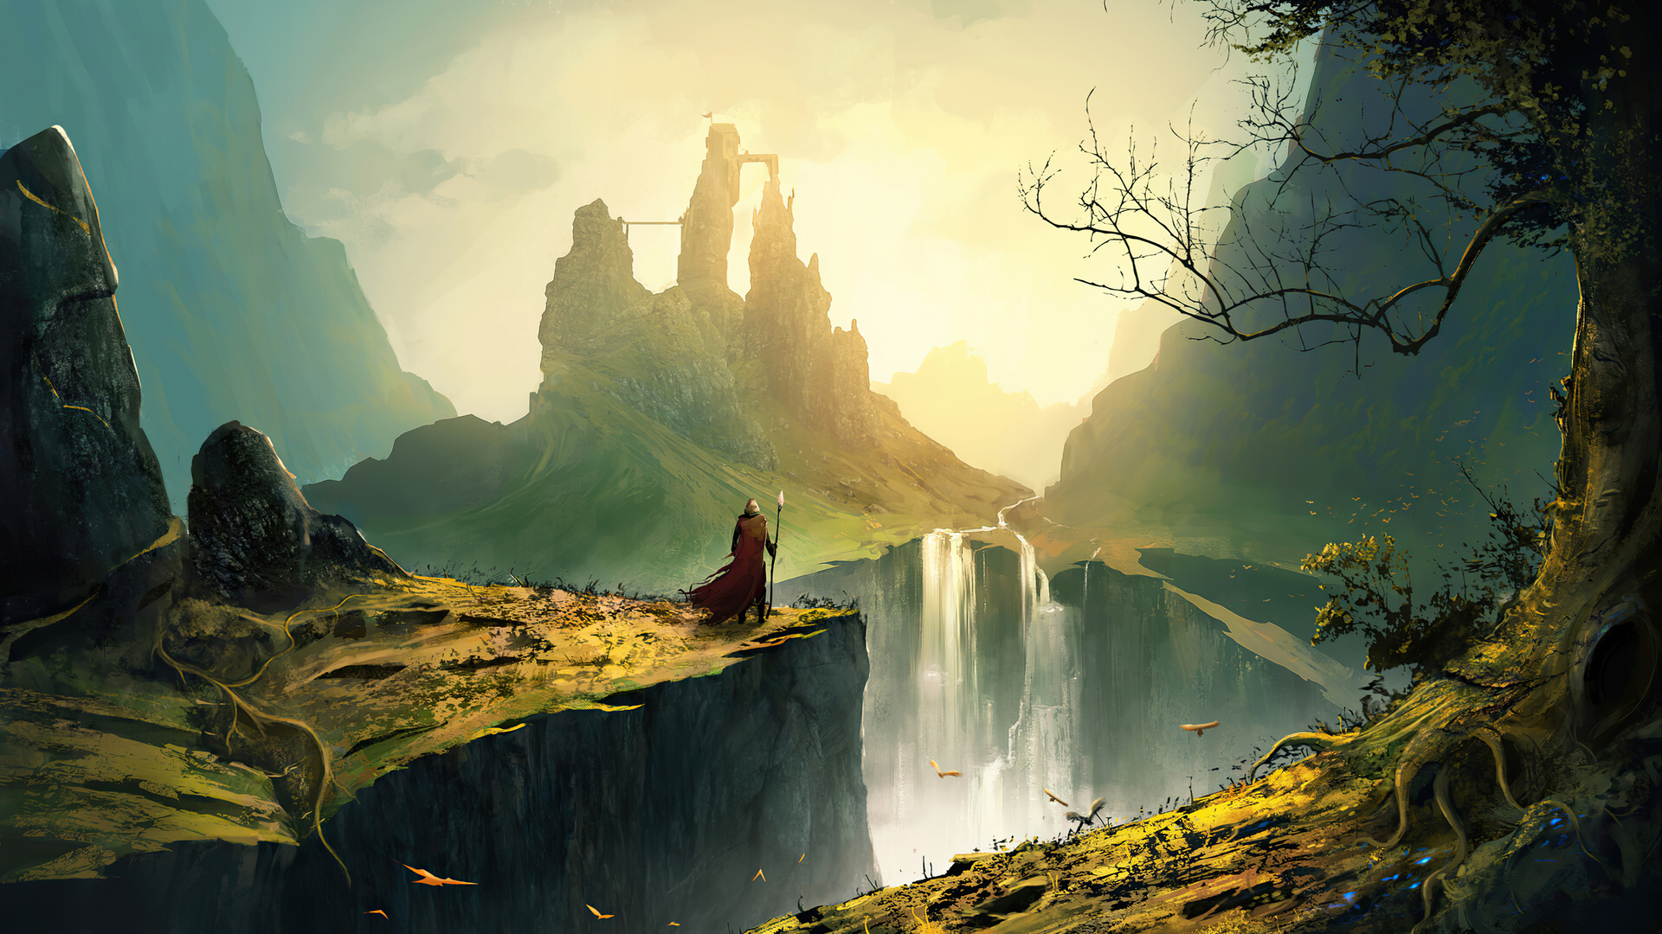
Storyline
The Librarian then tells Wonk the location of a person who borrowed the tome of invisibility out of gratitude for defending the library.
Wonk then goes on to various places in search of the tome, defending each place from a goblin attack, and then being told the next location the tome went to…
Notes:
Chandler

Slide 12
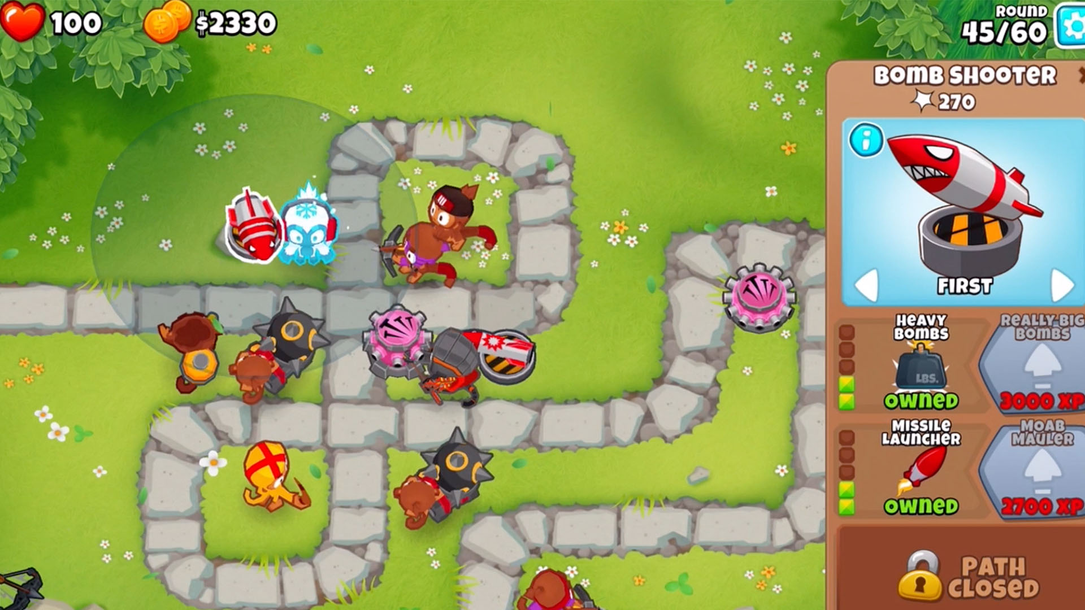
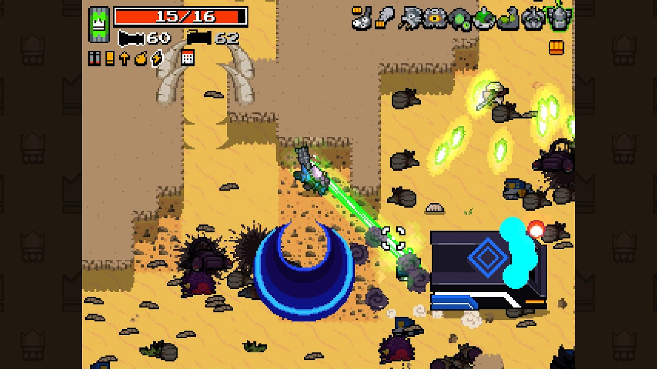
What Kind of Game is This?
Tower Defense + Top-Down 2D Shooter
Waves of enemies appear and try to attack a goal that you must defend.
You can defend the goal by summoning barriers and towers to create a maze that the enemies must walk through while being attacked by you and the towers you summoned.
Notes:
Chase

Slide 13
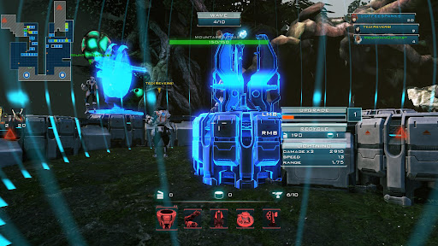
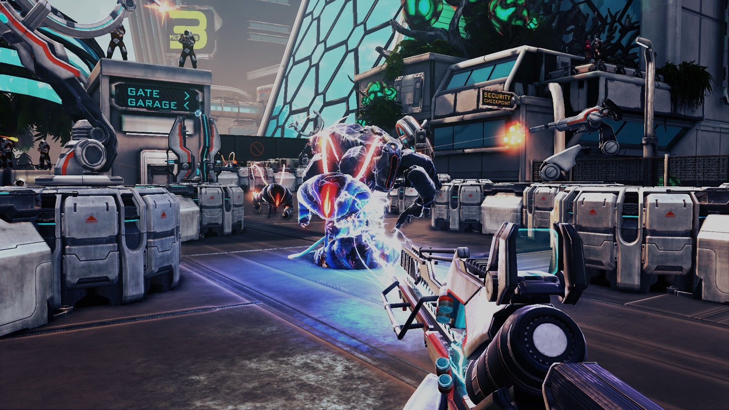
How Does it Work?
The game is divided up into levels, and levels are divided up into waves.
Two phases of each wave:
Setup
You can use mana to summon towers and barriers.
You can create a maze of barriers that enemies have to walk through while being attacked
Combat
You can use your spells to shoot enemies along with your towers.
You need to defend the goal and yourself from the enemies
Notes:
Chase

Slide 14
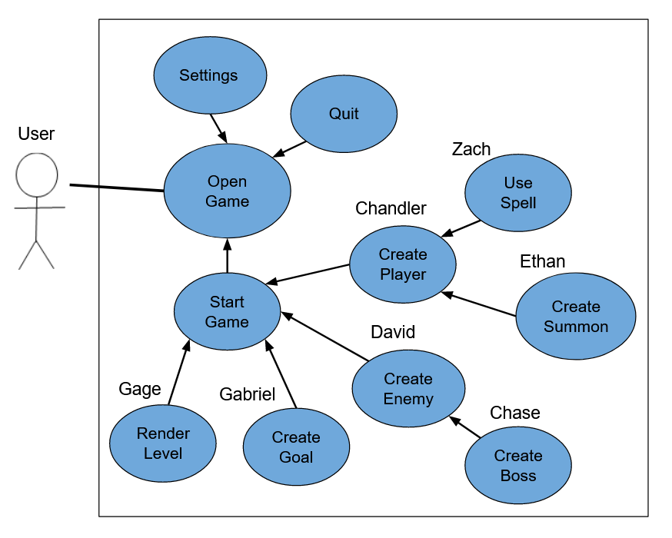
Global Use Case Diagram
Notes:
David

Slide 15
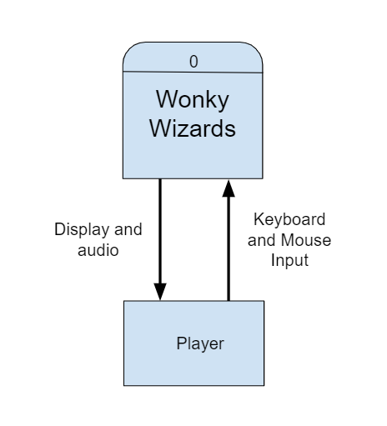
Context Diagram
Notes:
Gabriel

Slide 16
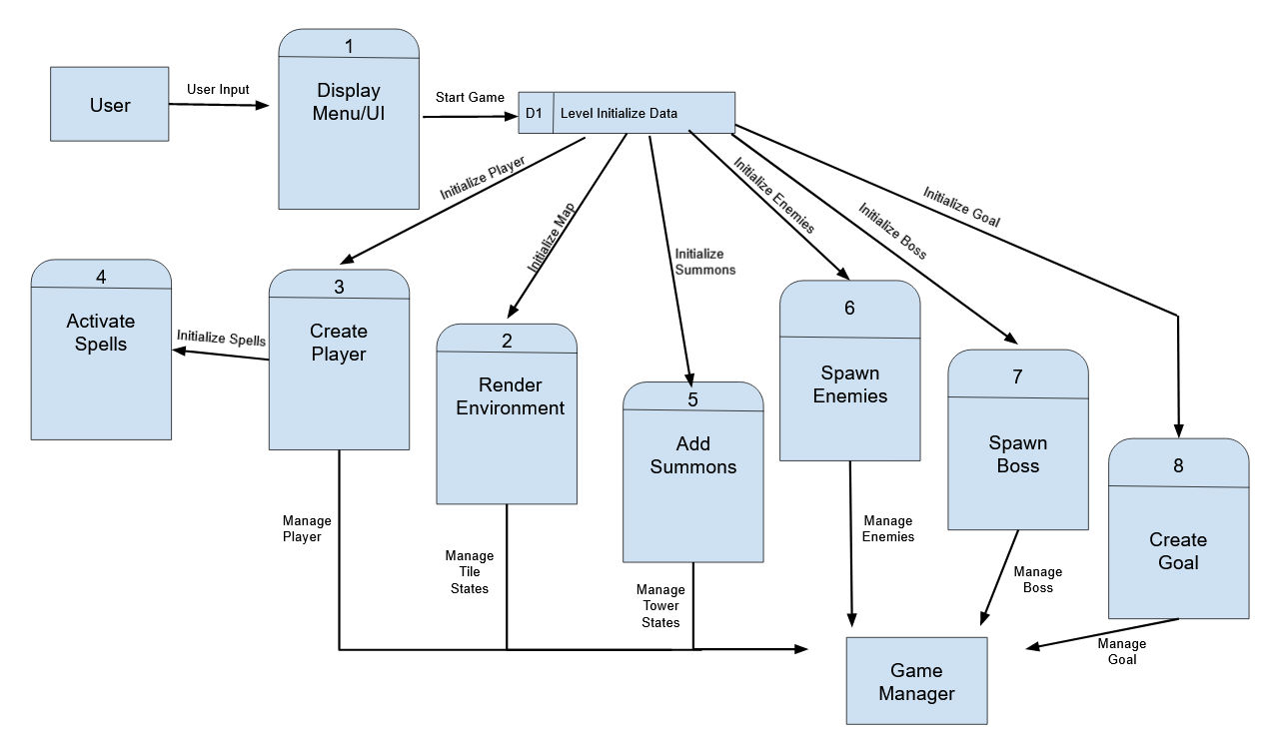
Diagram 0
Notes:
Zach and Gage

Slide 17
Individual Feature Breakdown

Slide 18
Ethan’s Feature

Slide 19
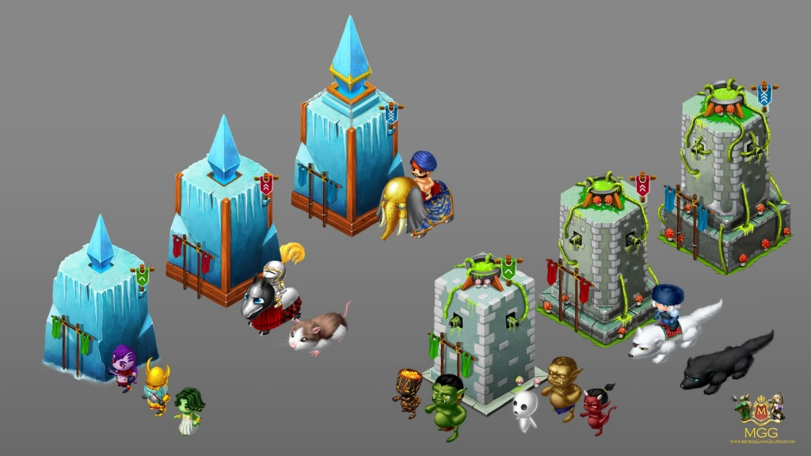
Introduction
Ethan Corgatelli
Feature: Summons (a.k.a. Towers)

Slide 20
Feature Explanation
Top Priority
A Tower Defense game fundamentally needs Towers
Brief feature explanation of Summons:
The Towers (called Summons in the context of this game) are an integral part of the gameplay.
Summons attack enemies as they attempt to walk towards the goal.
They are also used to create a maze that the enemies are forced to navigated.
There are various types of summons:
Barrier Ghost Pepper Enchanted Swords Astral Crossbow Portal Empowering Crystal | Shrubbery from the Realm of NI! Sven Mysterious Futuristic Wind Manipulation Device Big Chunk

Slide 21
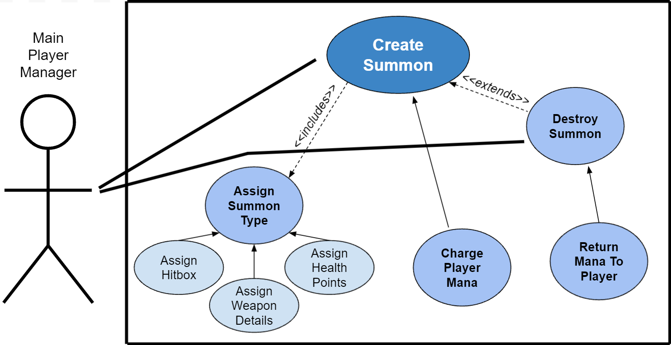
Use Case Diagram for Summons: Create Summon

Slide 22
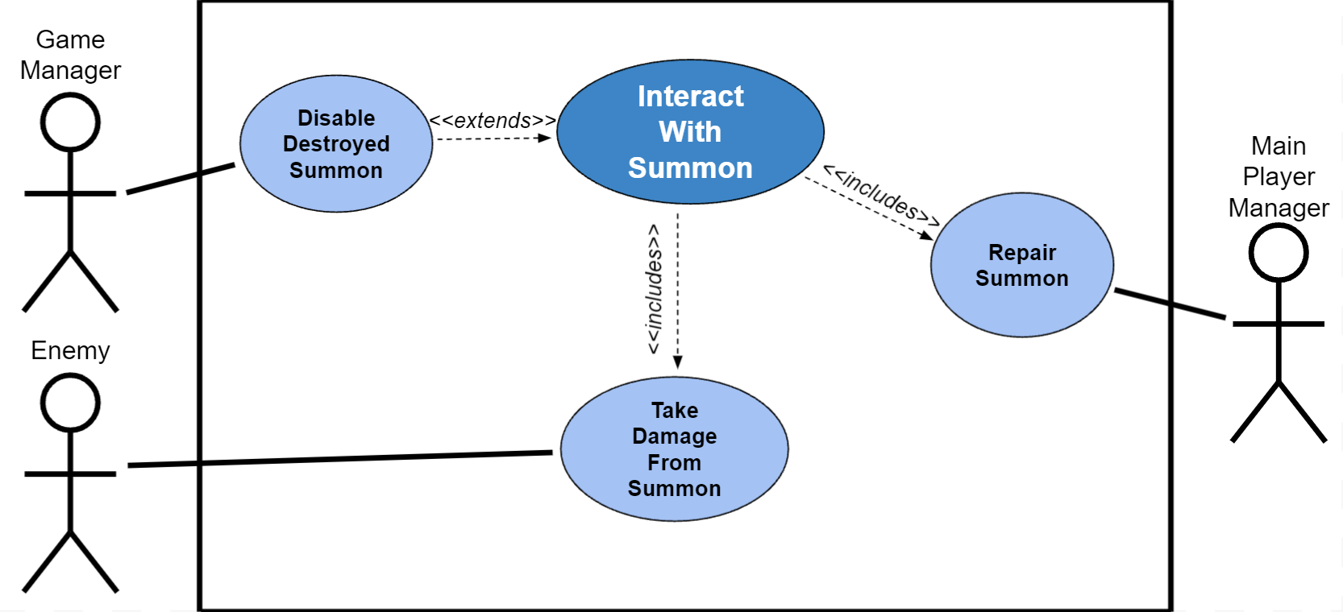
Use Case Diagram for Summons:

Slide 23
Complexity Explanation
Complexity of the Summons feature:
Creating superclass: high complexity, not too much work
Creating subclasses: lower complexity, but more implementation work
Potential issues down the road (details that could be hard):
Each tower has a unique special attack. Animation/FX will for these will be a challenge.
Balancing Summon stats. As a group, as we evolve the game we will have to tweak the stats for each summonable so that no summonable is too overpowered or too underpowered.
Any questions?

Slide 24
Chandler’s Feature

Slide 25
Introduction
Chandler Calkins
Feature: Player

Slide 26
Feature Explanation
Top Priority
Required for game to function
What does this feature accomplish?
User will be able to input controls
Player will respond to controls
Moving around (camera following movements)
Looking around (camera shifts and zooms based on cursor location)
Summoning towers in certain places
Casting Spells in certain directions
The player object will allow the user to complete the goal of the game
It will also be an opportunity for the user to lose the game

Slide 27
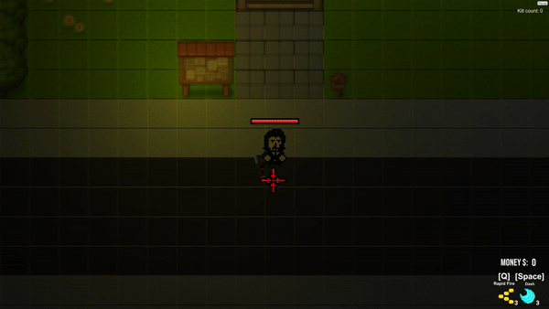
Champion Feature

Slide 28
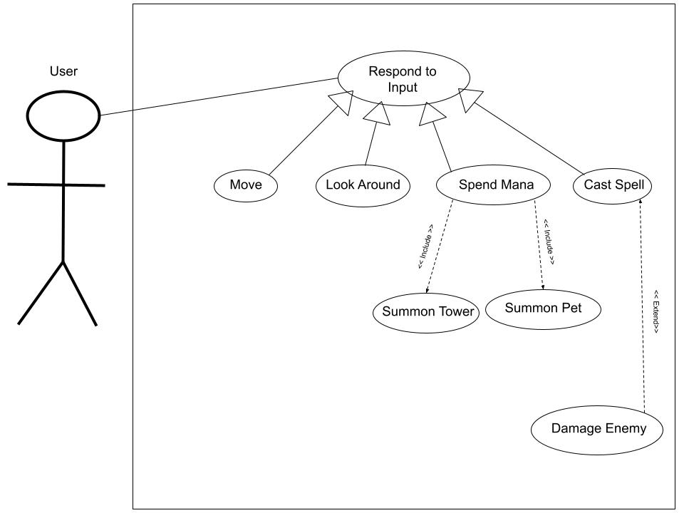
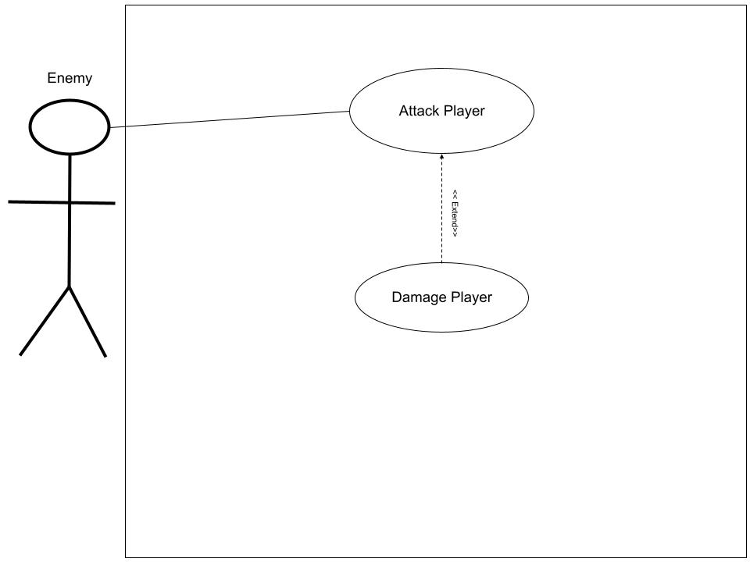
Use Case Diagram for the Player

Slide 29
Complexity Explanation
Complexity (perhaps also tedium) of work relative to other features
Easy - Medium complexity
It will be a lot of work, but the work will be simple
Describe potential difficulties
Trouble interacting with all other aspects of the game
The player will be required to interface with almost everybody else’s feature in the game
Any questions?

Slide 30
Gabriel’s Feature

Slide 31
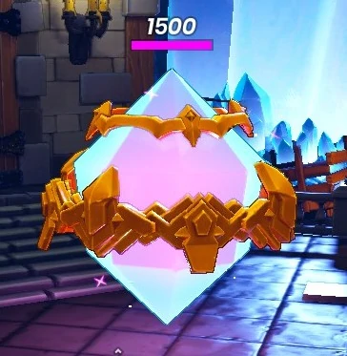
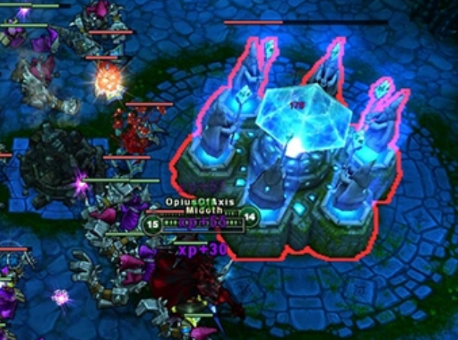
Introduction
Gabriel Jones
Feature: Goal Building - Enemies need a place to go!

Slide 32
Feature Explanation
High/Med Priority
Core component of the game
So what does this feature accomplish?
Allows for more diverse gameplay, gives the player another task to manage
Creates another lose condition - adds game complexity/difficulty scaling
Allows for future game expansion
Different goals per level
Each goal can have unique defensive properties (hp/attack types)

Slide 33
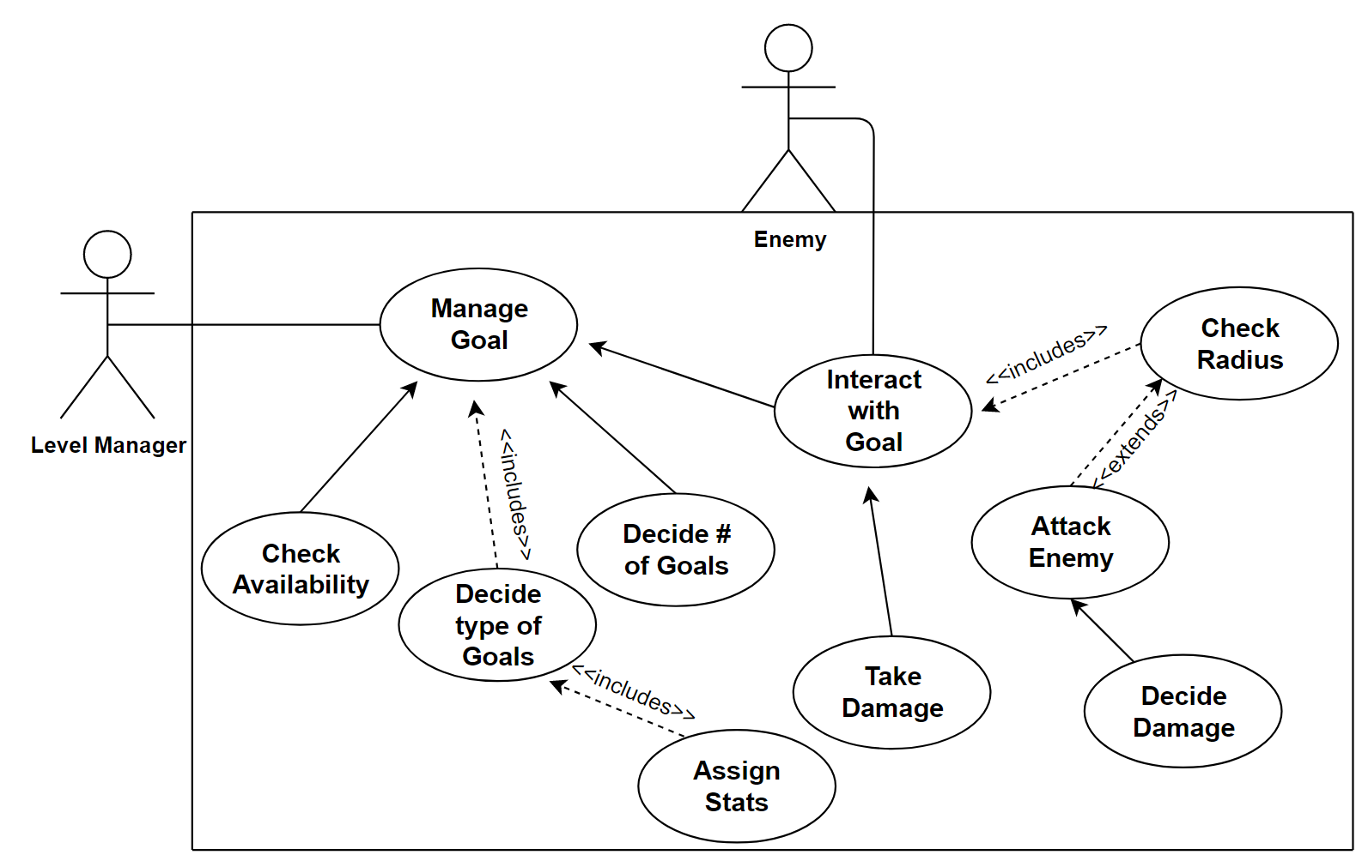
Use Case Diagram Walkthrough for Enemy Goals

Slide 34

Complexity Explanation
Complexity (perhaps also tedium) of work relative to other features
Medium overall complexity
Large overarching class with subclasses for each type of goal
Individual instances of each goal will need their own
Will require work/collab with other team members
Goal might need animations for different states/defending itself
Potential for enemy pathfinding complications
Potential difficulties?
smol difficulty
Stat (hp/defensive capability) balancing
Any questions?

Slide 35
Zach’s Feature

Slide 36
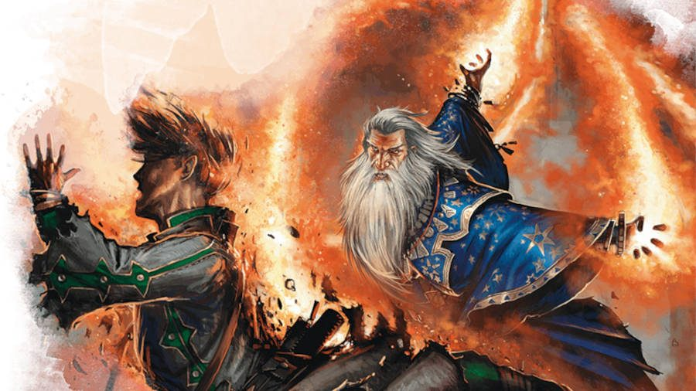
Introduction
Zach Heimbigner, Team Lead 3
Feature: Spells
The Spells are going to be another tool for the player to use in order to defeat enemies before they get to the goal.

Slide 37
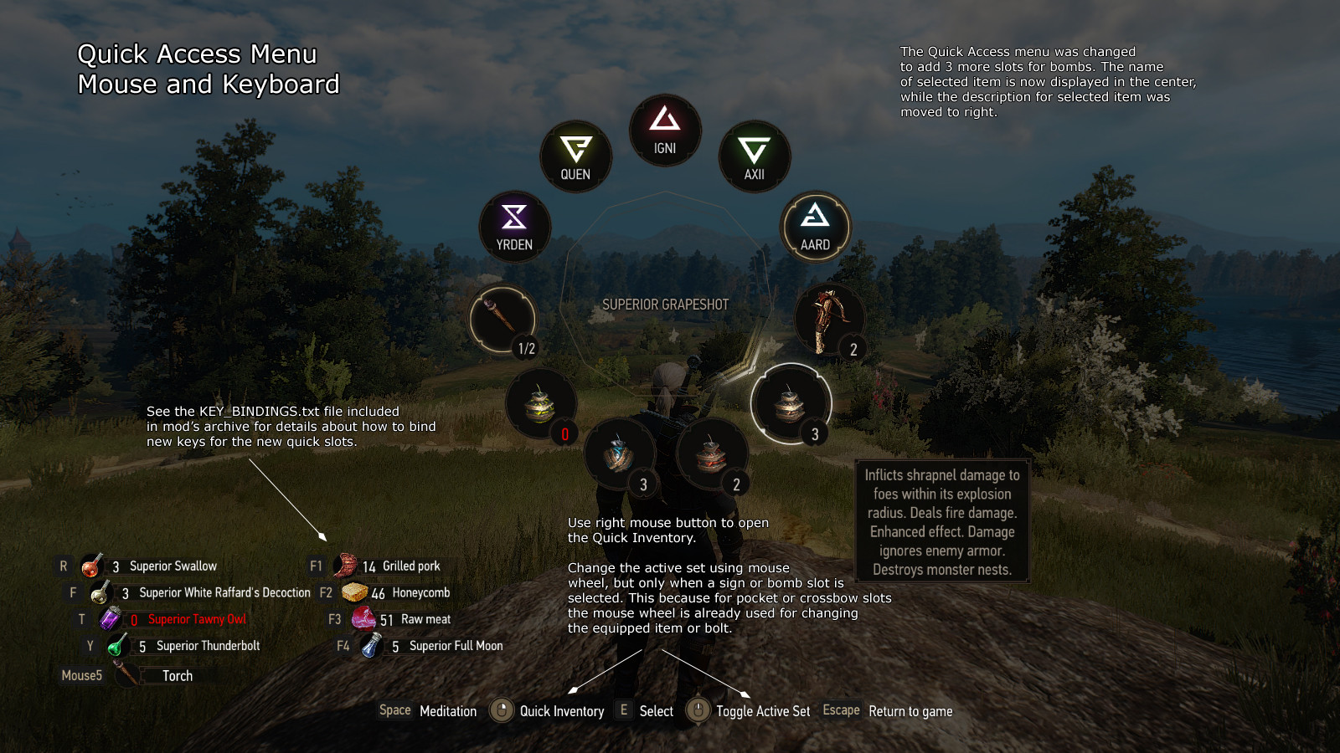
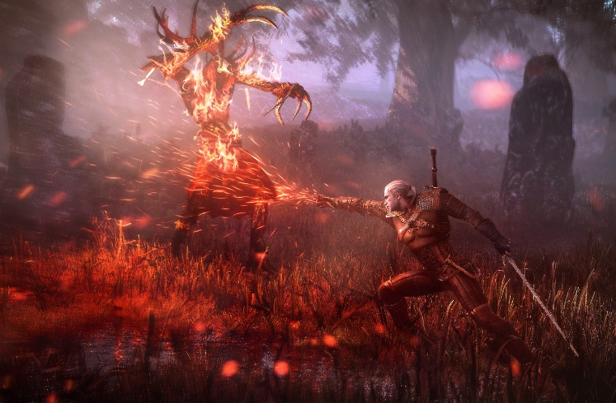
Feature Explanation
Priority: High (Affects Playability)
Attributes:
DPS (Damage/Sec)
Range
Effect
Color
Travel Time
Hitbox Size

Slide 38
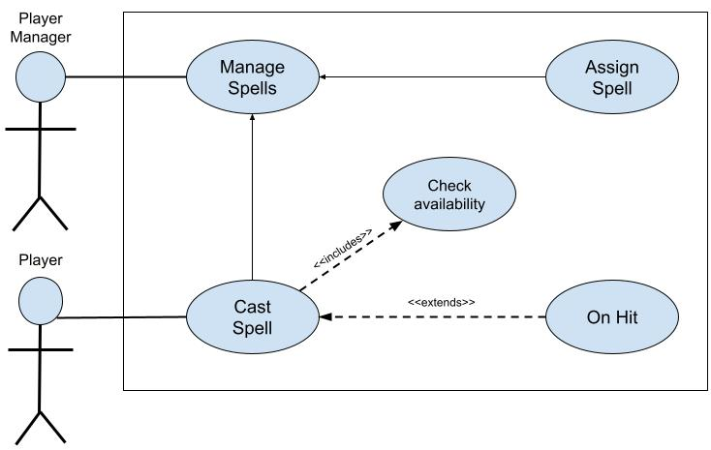
Use Case Diagram for Spells

Slide 39

Complexity Explanation
Complexity: Medium
Construction: Easy
Implementation: Hard
Main Concern: Game Balance!
Range (too short/ too long)
Damage (instant kill/ ineffective)
Cool Downs (spam/ never up)
Any questions?

Slide 40
Chase’s Feature

Slide 41
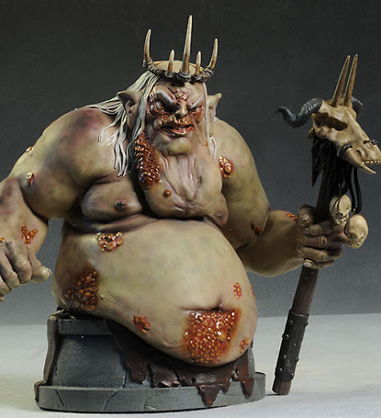
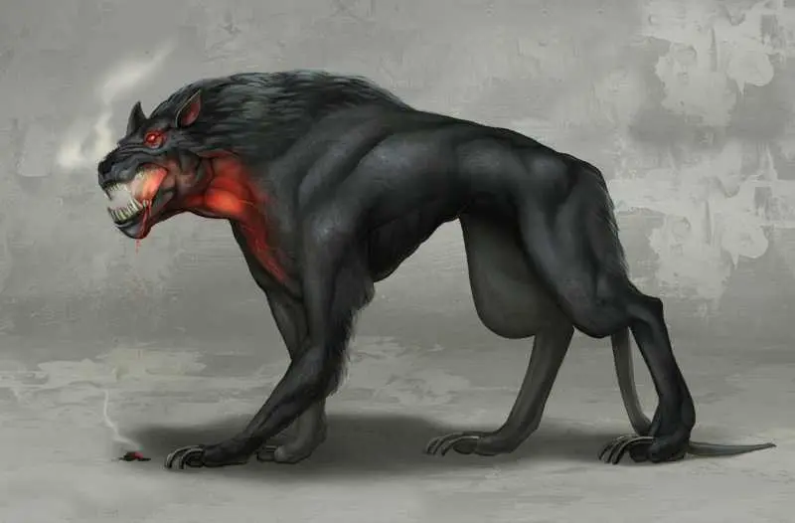
Introduction
Chase Gornick, Team Lead 4
Feature: Bosses/Sprites and Animations
Bosses are going to be one of the “end game”
enemies that you will be fighting as the player
meaning that they will be some of the strongest
enemies you will face as the player.

Slide 42
Feature Explanation
Priority of my feature is medium - high
This feature is fairly important due to the fact that it is the final interpretation a player has of the game and an epic challenging but beatable final boss battle always makes game better.

Slide 43
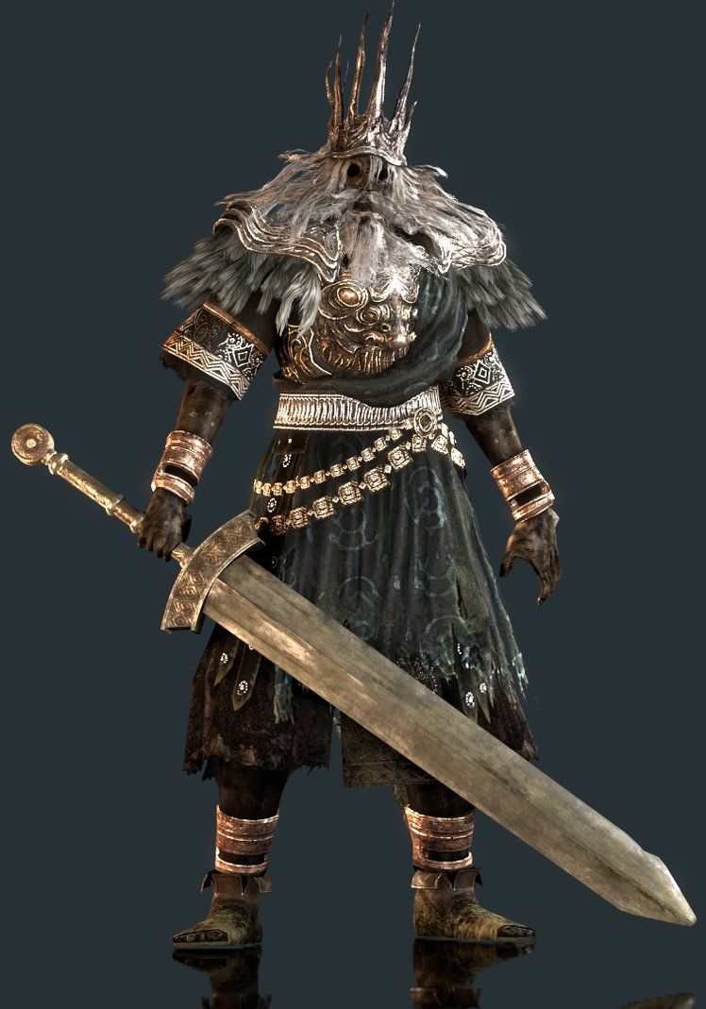
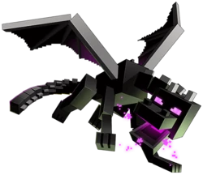
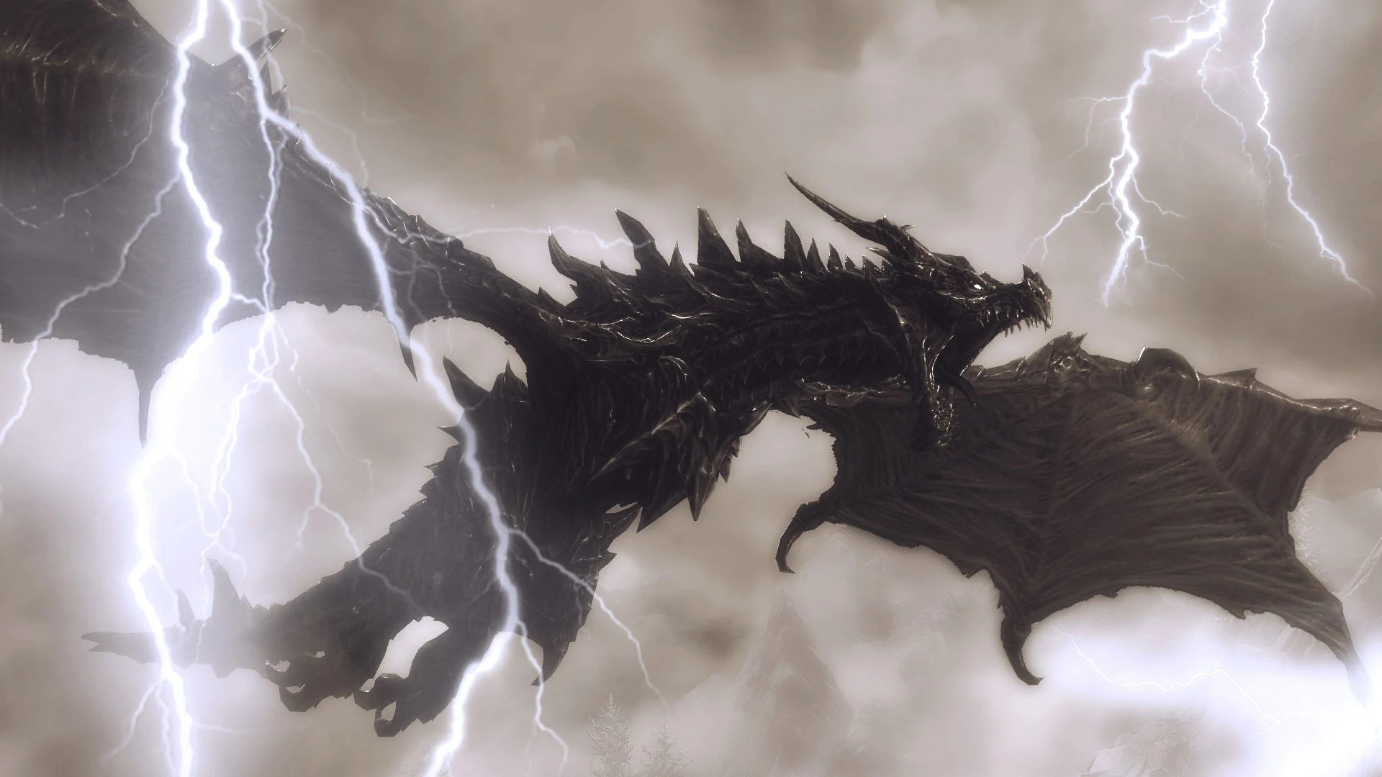
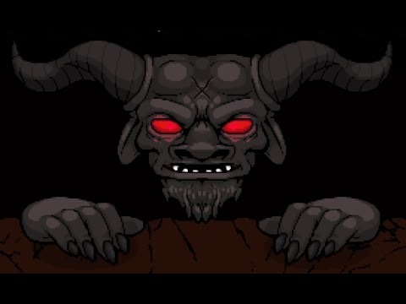
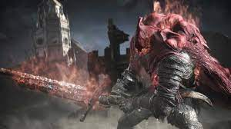
Bosses From Games That I Find Memorable

Slide 44
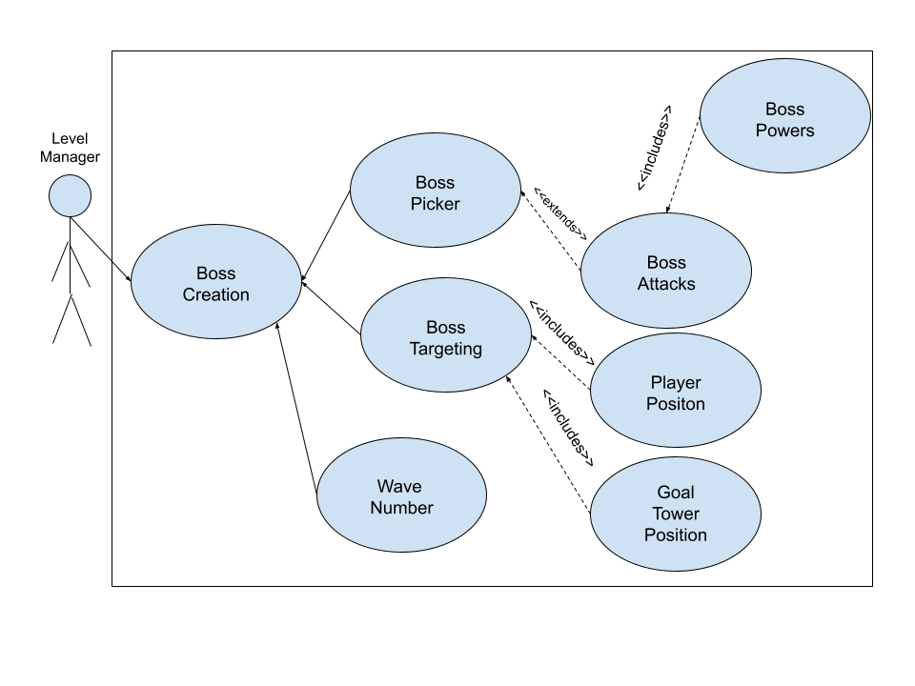
Use Case Diagram for (Bosses)

Slide 45
Complexity Explanation
Complexity of work relative to other features
Could Clash with player mechanics
Could Clash with other enemy mechanics
Potential Difficulties
Overzealous Design
Attributes and Mechanics
Any questions?

Slide 46
David’s Feature

Slide 47
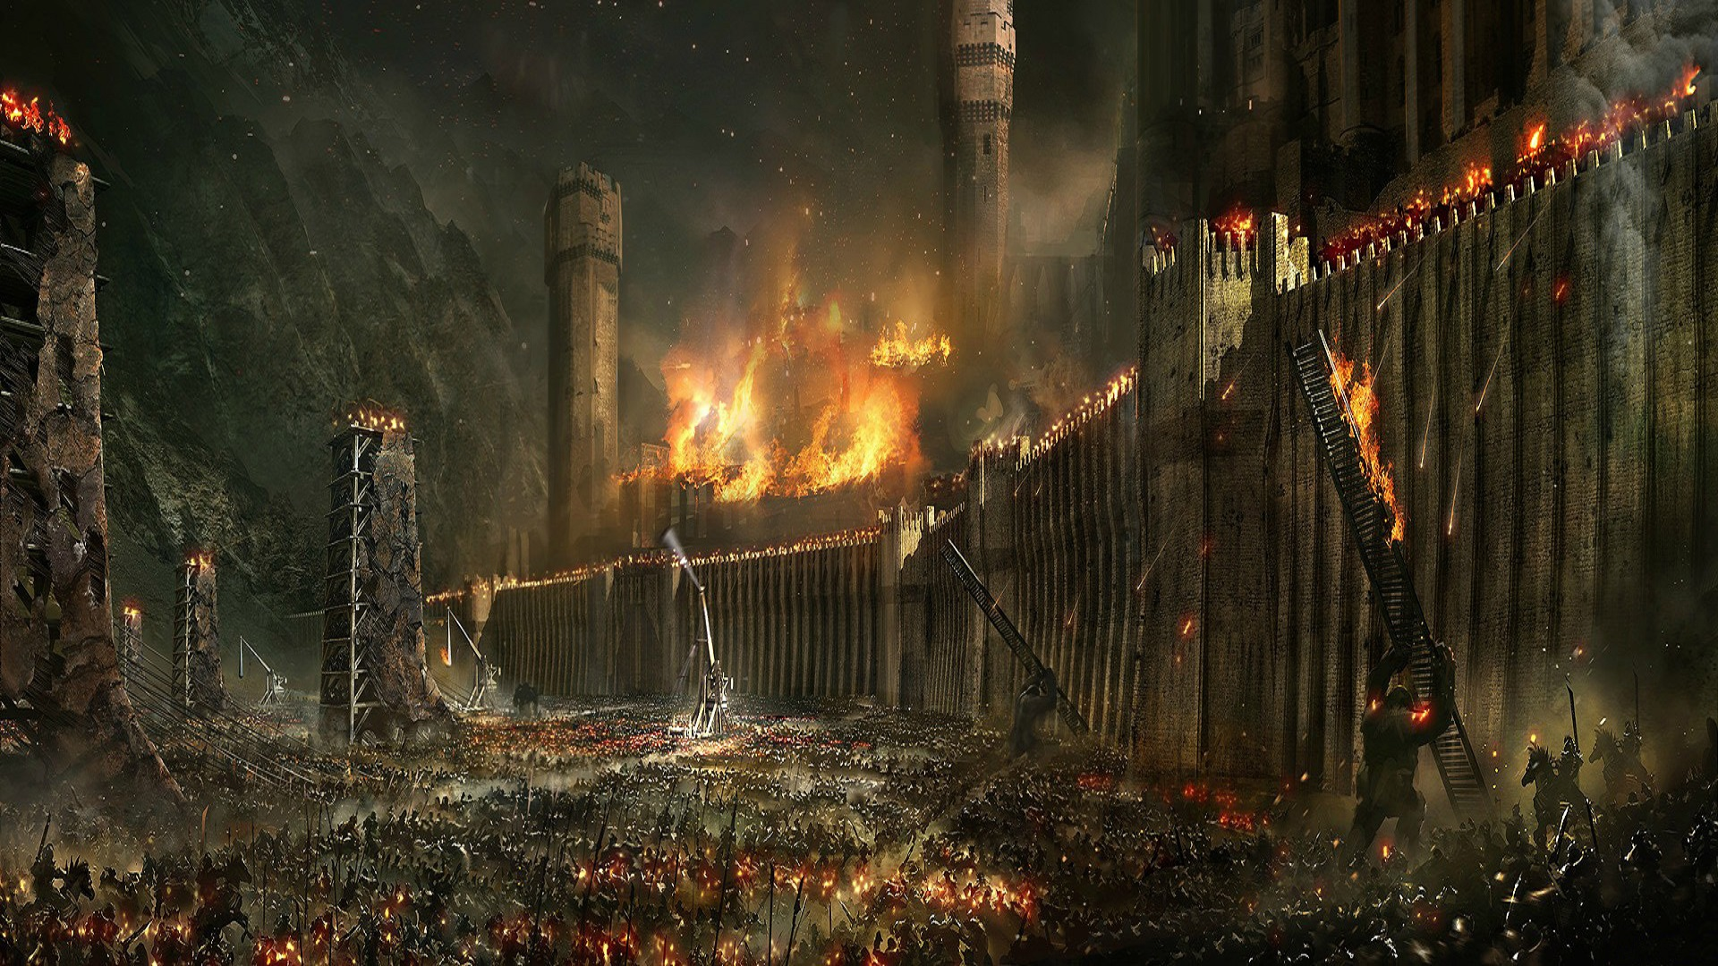
Introduction
David Bush
Feature: Enemies
The enemies will be spawned at the start of each round and will move towards a goal target. They will also be able to interact with the player and summons.

Slide 48
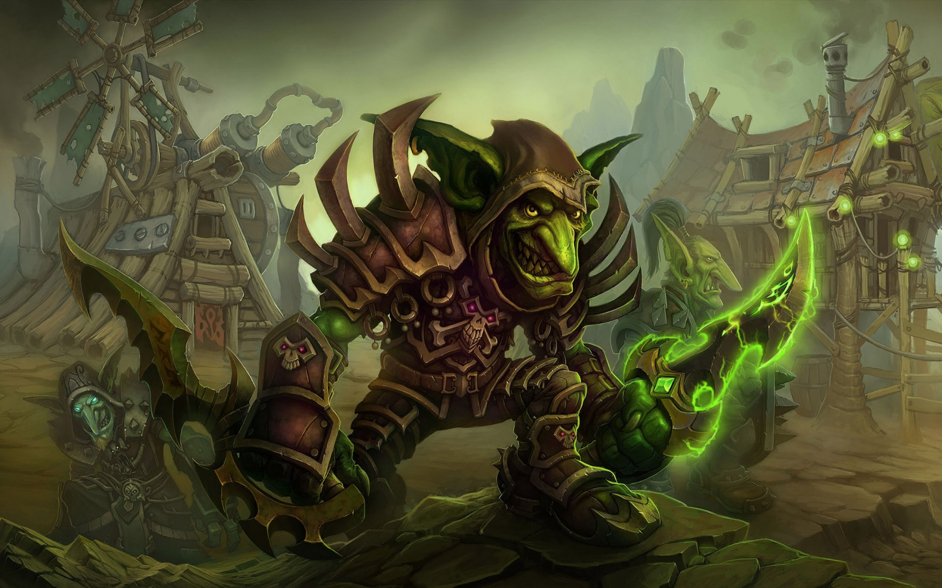
Feature Explanation
Priority: High (Essential for game play)
Creating Enemy
Number of enemies
Type of enemy
Attributes (hp, damage, speed, abilities, ect.)
Enemy Interactions
Receiving Damage
Dealing Damage

Slide 49
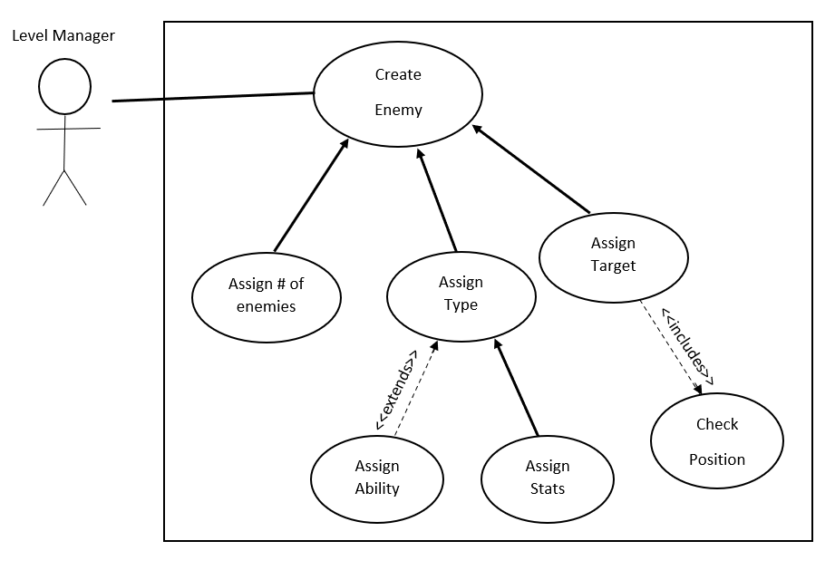
Use Case Diagram for Creating Enemy

Slide 50
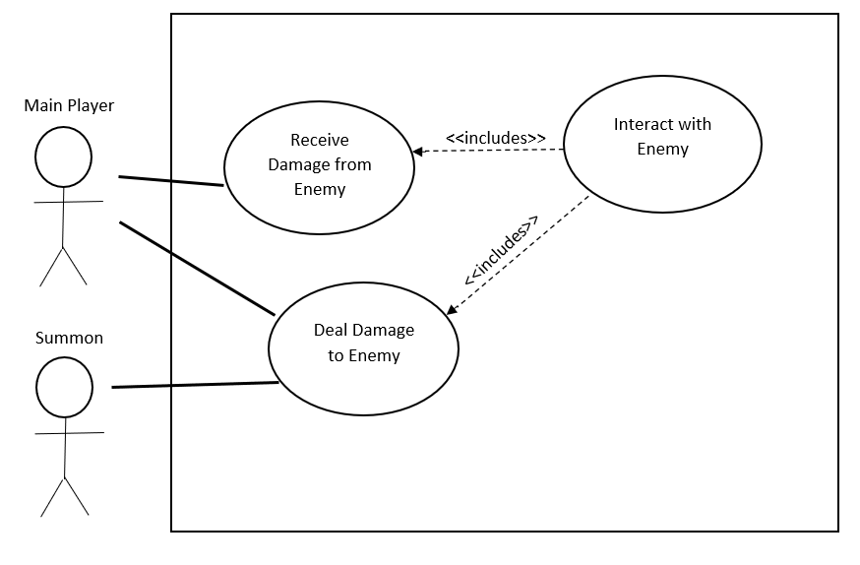
Use Case Diagram for Interacting With Enemy

Slide 51
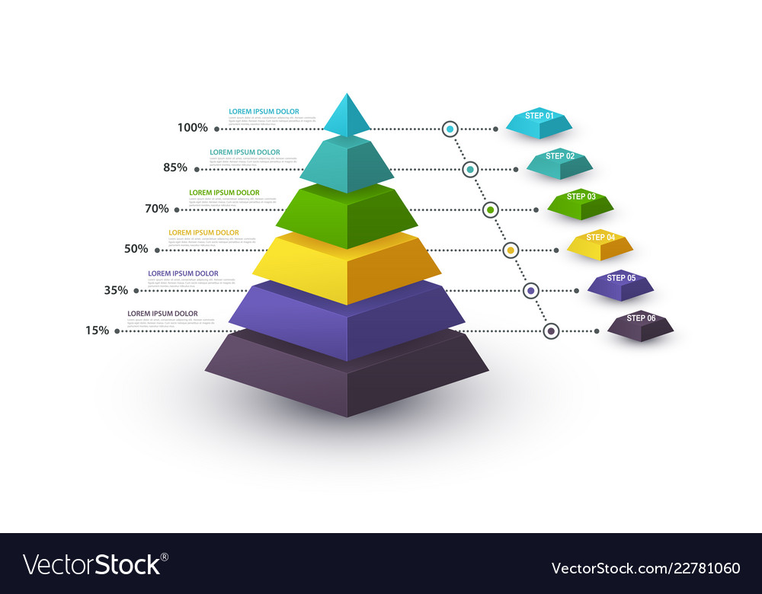
Complexity Explanation
Overall Complexity: Medium
Each enemy type will have a unique subclass but share the same superclass
There’s going to be interactions between the enemies and the player/summons which will require collaboration with other team members
Potential Difficulties
Balancing enemy units
Targeting and interactions with the player
Pathfinding the goal target
Any questions?

Slide 52
Gage’s Feature

Slide 53
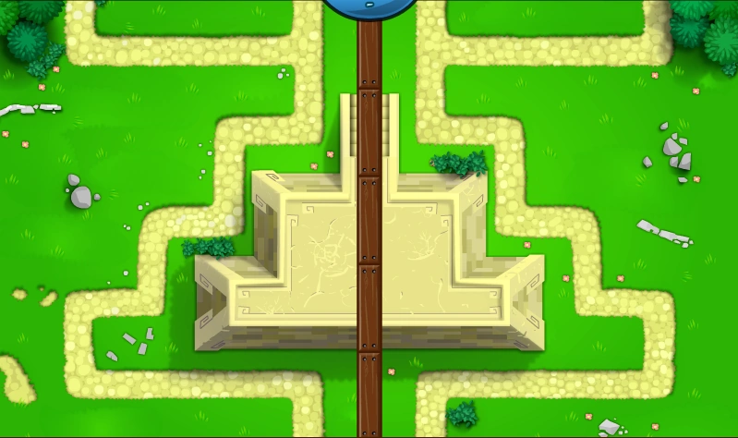
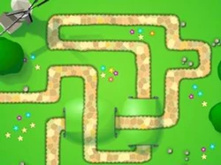
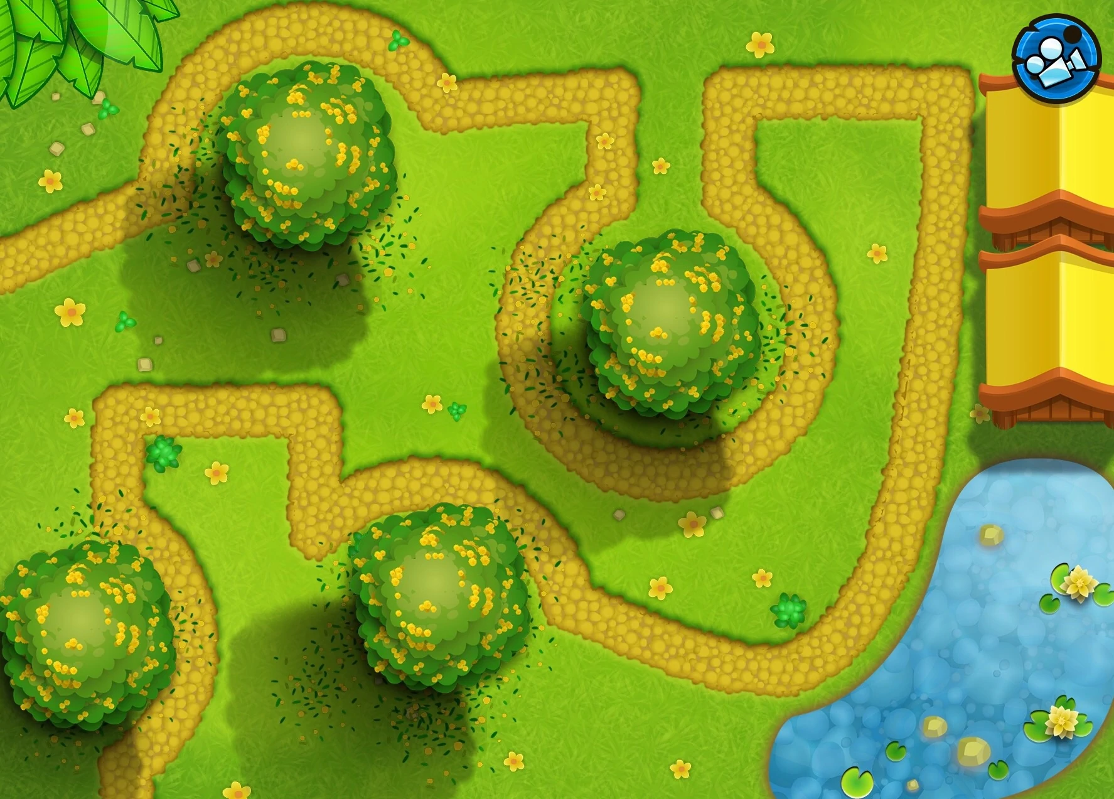
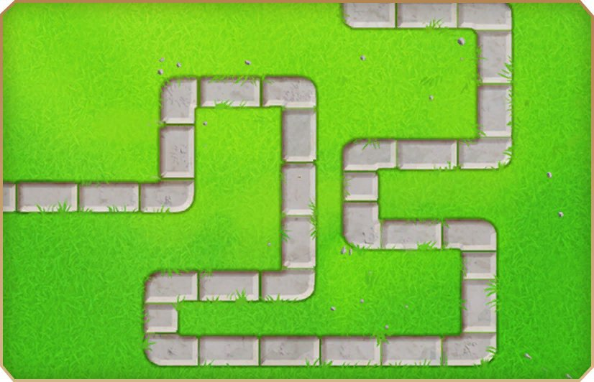
Introduction
Gage Nardi
Feature: Levels
8 total levels
7 different map settings
Spawn World Elements
Different Enemy Wave Size and Limit

Slide 54
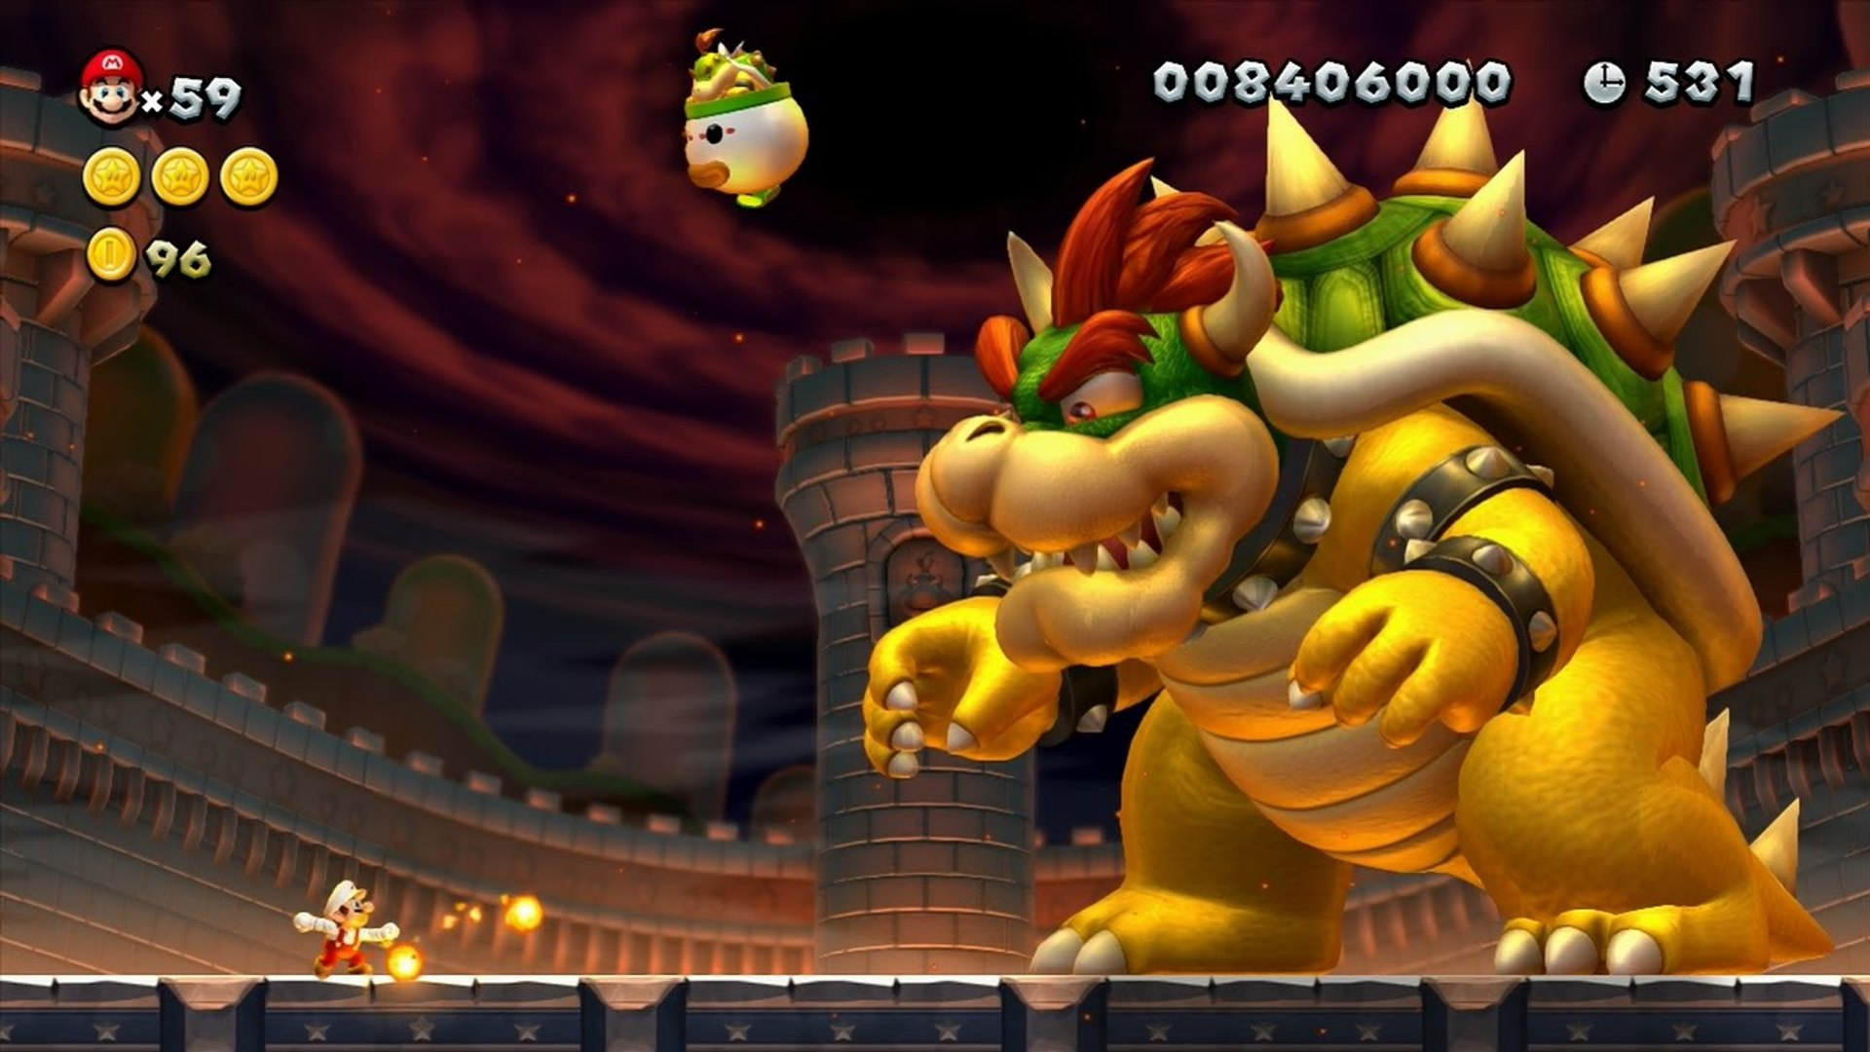
Feature Explanation
Priority: High
Essential for gameplay
Create World Level:
Increase in difficulty per level
Each level has different elements
Some levels have a boss (or multiple bosses)

Slide 55
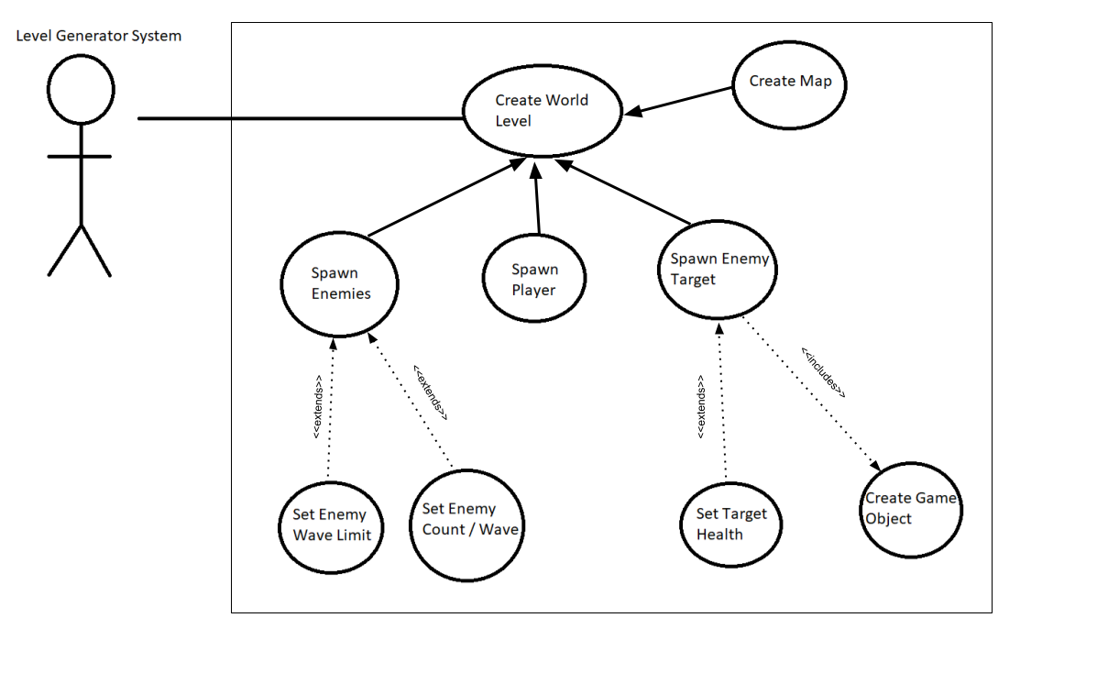
Use Case Diagram for Levels

Slide 56
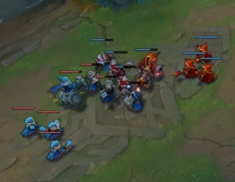

Complexity Explanation
Complexity: Medium
Spawn ...
Enemies
Boss(es) [if any]
Enemy goal
Player
Tower placement
Difficulties:
Walkable tiles vs. un-walkable tiles
Sensible enemy wave limit for fun and difficulty
Any questions?

Slide 57
That’s it!
Wonky Wizards by Bloonagins

